Slide 1
Chicago Restaurant Health Inspection Machine Learning Pipeline
Mark Lawley, PhD, PE
May 2025

Slide 2
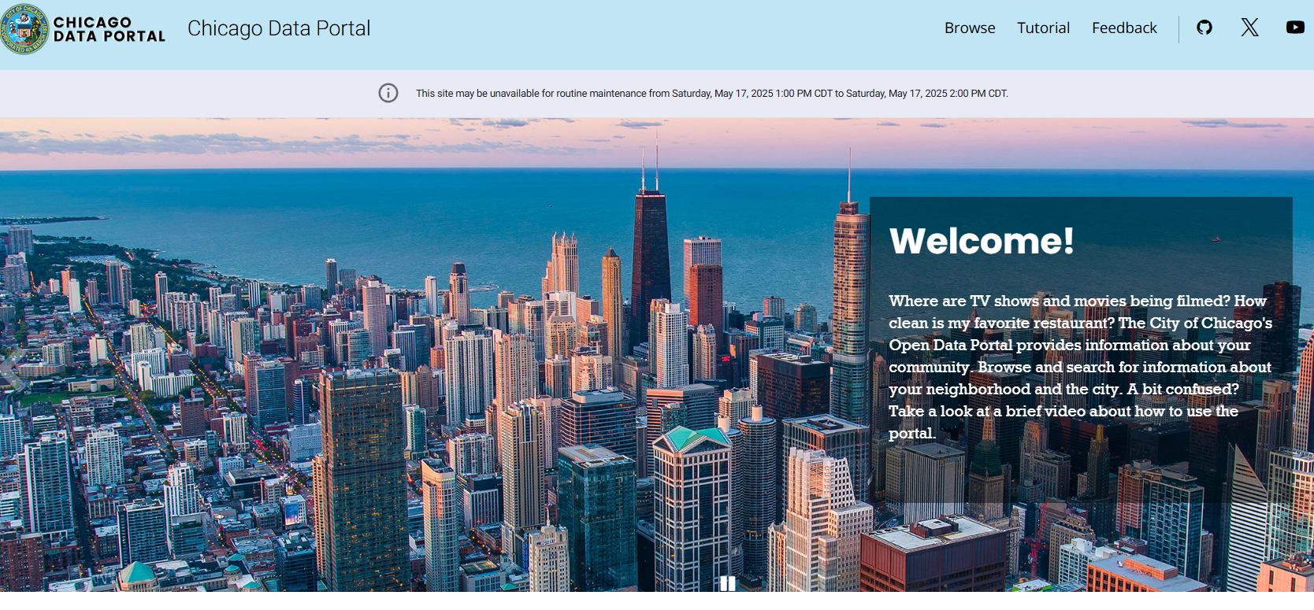

Slide 3

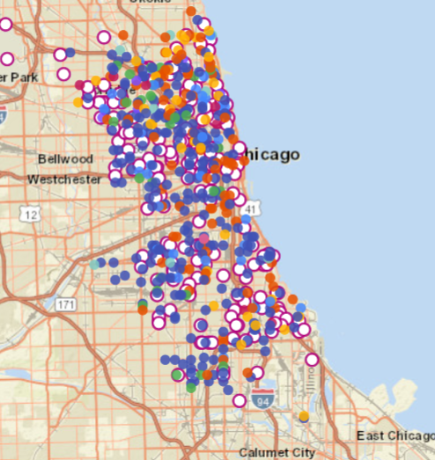
Overview – Chicago Food Inspections
Inspections performed by the Department of Public Health
~ 15,000 food establishments
~ 40 inspectors
~ 3 types of inspections, license, routine, complaint-based
~ Inspection frequency by facility risk level
Risk Level 1: 2 inspections per year
Risk Level 2: 1 inspection per year
Risk Level 3: 1 inspection every other year
~ 63 violation codes available at
City of Chicago :: Understand Health Code Requirements for Food Establishments

Slide 4
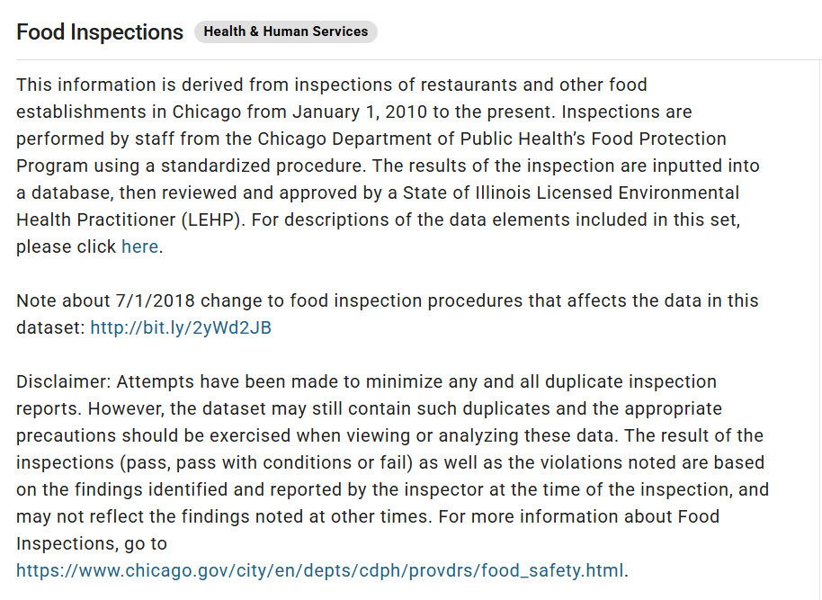
Food Inspection Data Set
Available at Food Inspections | City of Chicago | Data Portal
Derived from inspections of restaurants and other food establishments
Dates from January 1, 2010 to present
Updated Daily
292K rows, 17 columns
Columns include
Facility name
Address
Inspection ID and date
Codes violated
Results (pass, conditional pass, fail)
API Endpoint: https://data.cityofchicago.org/resource/4ijn-s7e5.json
The data is very messy, many redundancies, missing values, typos, ect.

Slide 5
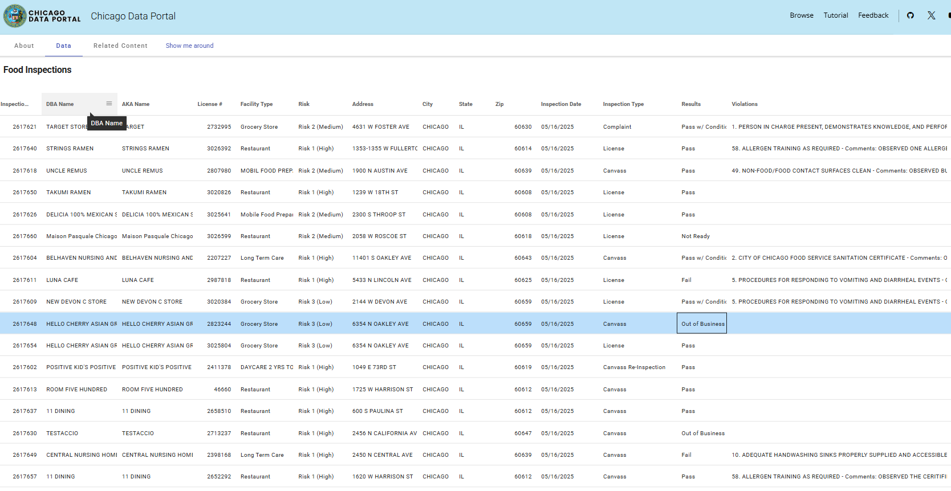

Slide 6
Machine Learning Use Case
A public health inspector has completed an inspection of a restaurant and has to decide whether it should be a pass, pass with condition, or fail
The decision needs to be consistent with general historical practice.
Goal: A decision support tool that accepts data collected from the on-site inspection and makes a recommendation about pass, pass with condition, or fail that is consistent with historical inspection decisions.
Objective: Build cloud-native machine learning pipeline that collects, cleans, transforms, and stores data, supports exploratory data analysis, machine learning training and prediction, and inspection report generation.
Design Architecture ~ Containerized microservices implemented in the Google Cloud Platform.

Slide 7


Get
Put
Post
Google
Cloud Scheduler
Chicago Open Data Portal
Scheduler
Trigger (go)
Pipeline Controller
(Streamlit)
Extractor (go)
Data Lake (GCS)
data_bucket_1
raw data json
_manifest
performance metrics
Big Query
Cleaner (polars)
row_data
tables
views
column_data
tables
views
Metrics
tables
views
EDA Dashboard
(Streamlit)
data_bucket_2
cleaned data ndjson
_manifest
Loader
(python)
data_bucket_3
cleaned data parquet
_manifest
ML Training / Service
(Scikit, tensorflow)
POST predict
data_bucket_4
restaurant risk reports
Grafana
Extractor DB
ML Dashboard
(Streamlit)

Slide 8














Pipeline Technologies

Slide 9
Demonstrations
The operation of the pipeline will be illustrated through several demonstration videos.
Data extraction, cleaning, loading
Exploratory data analysis
Machine learing model performance
Risk report generation for decision support
Continuos integration and deployment using Git

Slide 10
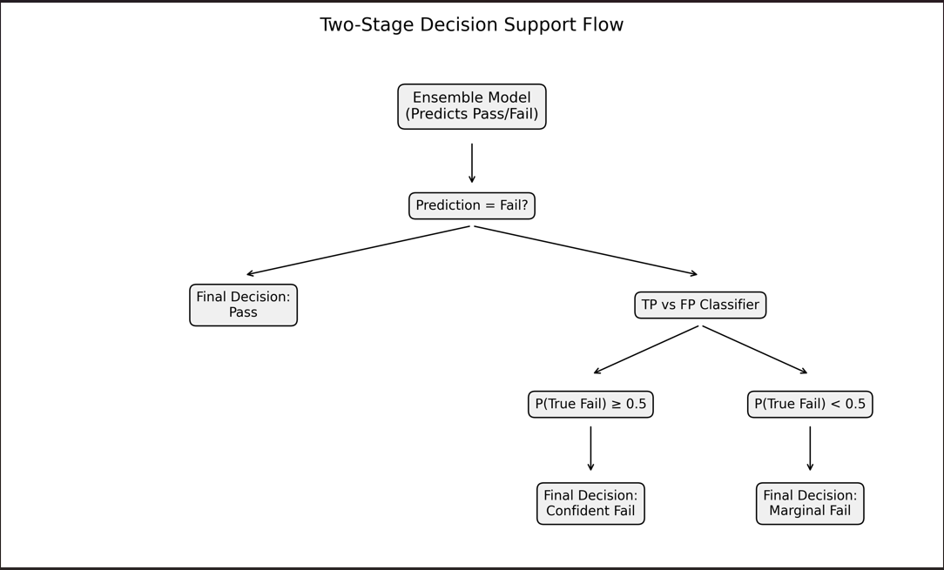

Slide 11
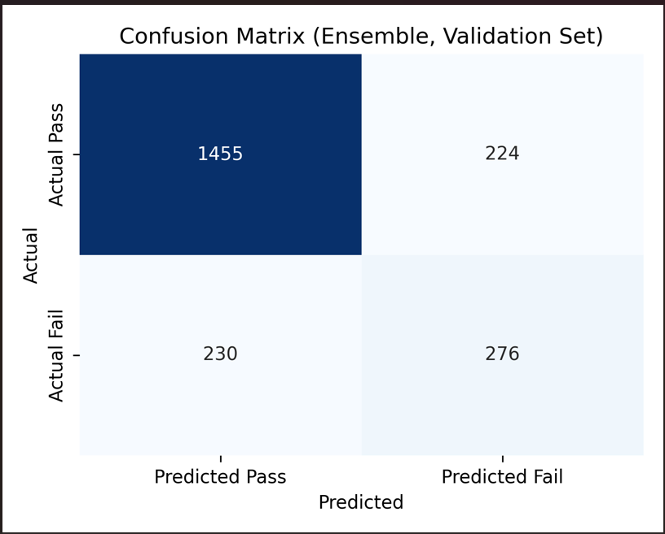

Slide 12
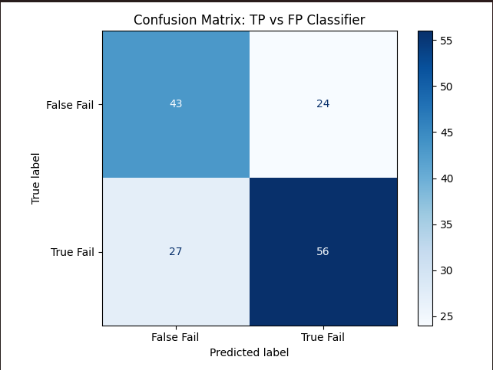

Slide 13
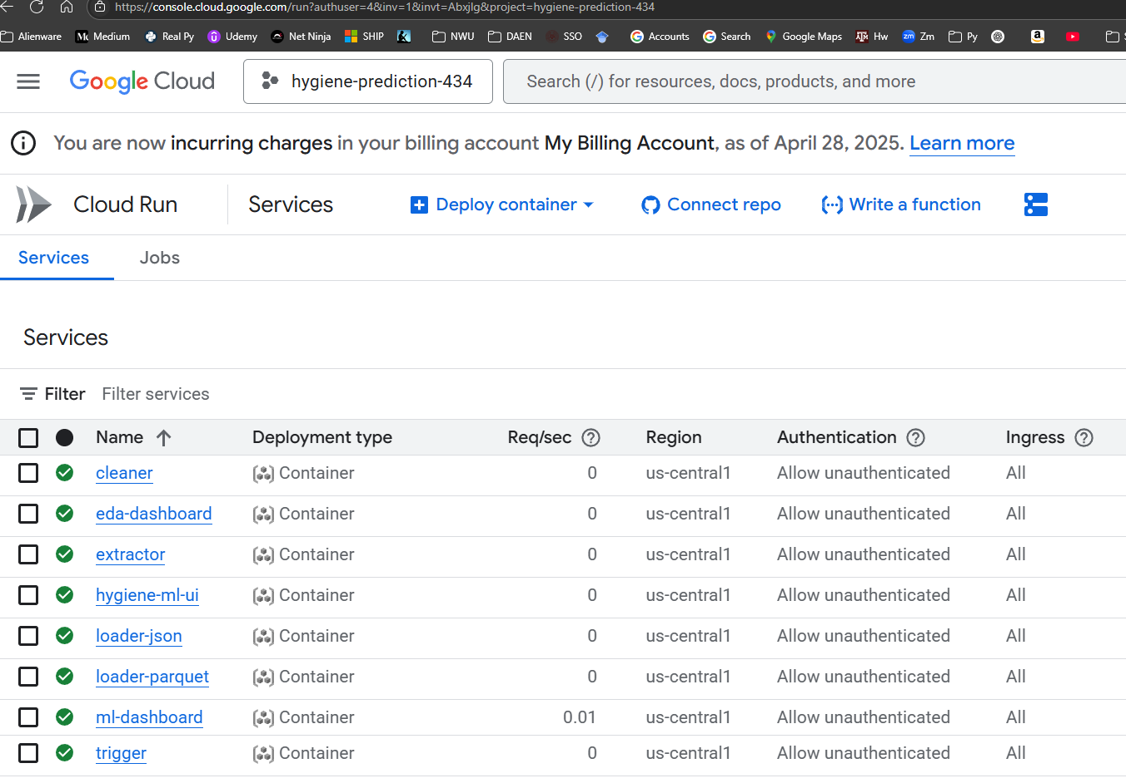

Slide 14
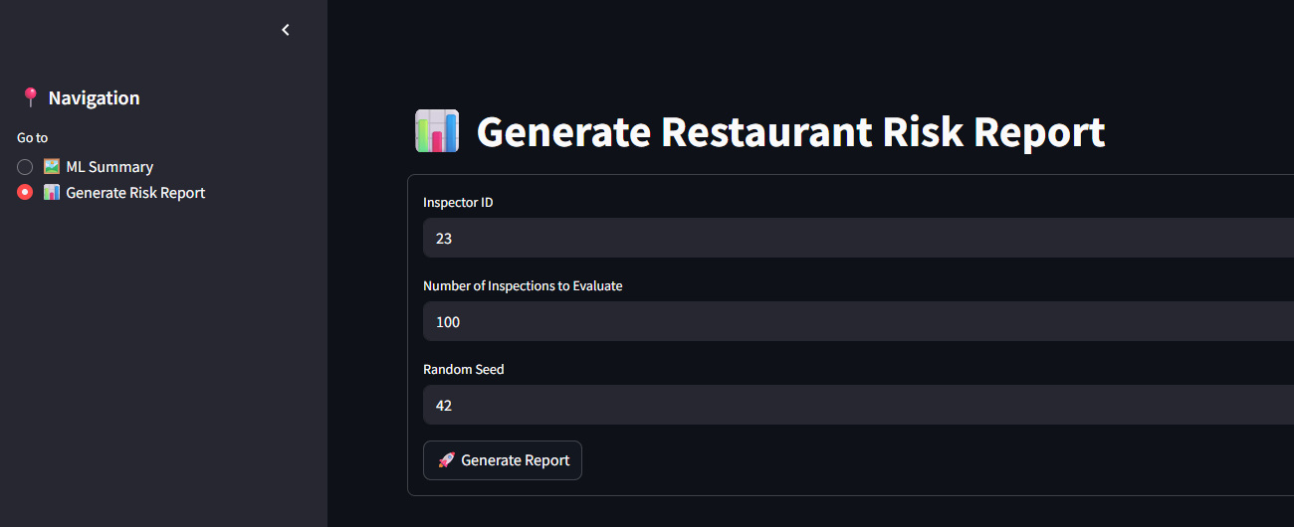

Slide 15
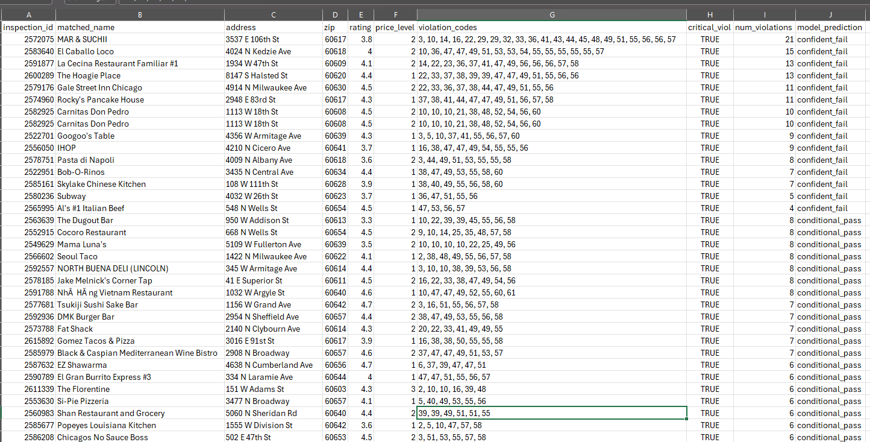

Slide 16
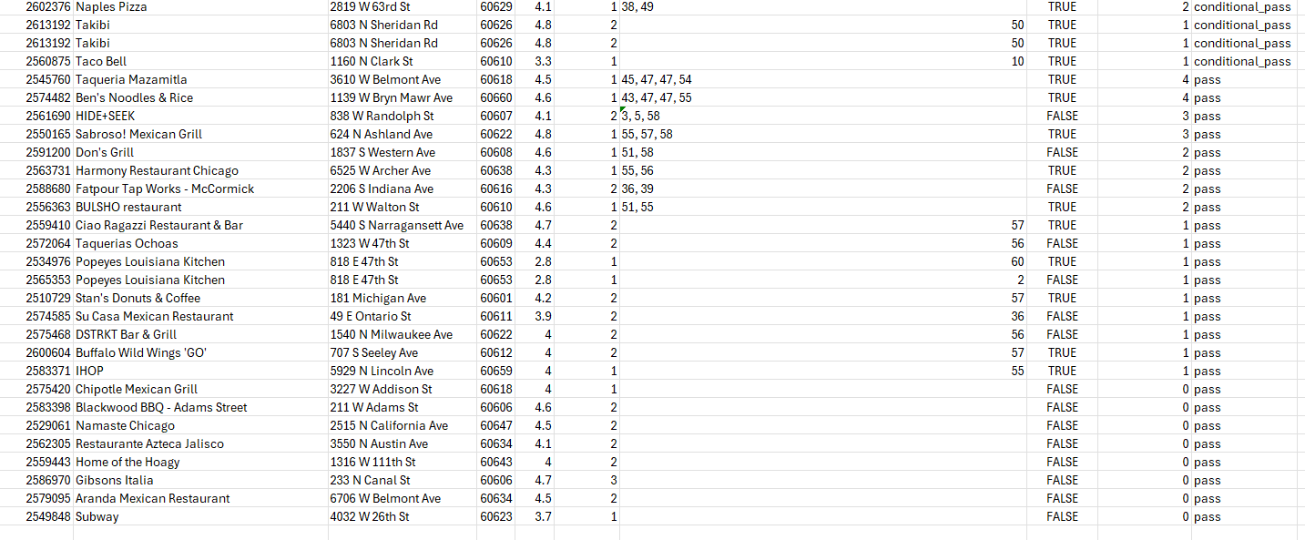

Slide 17
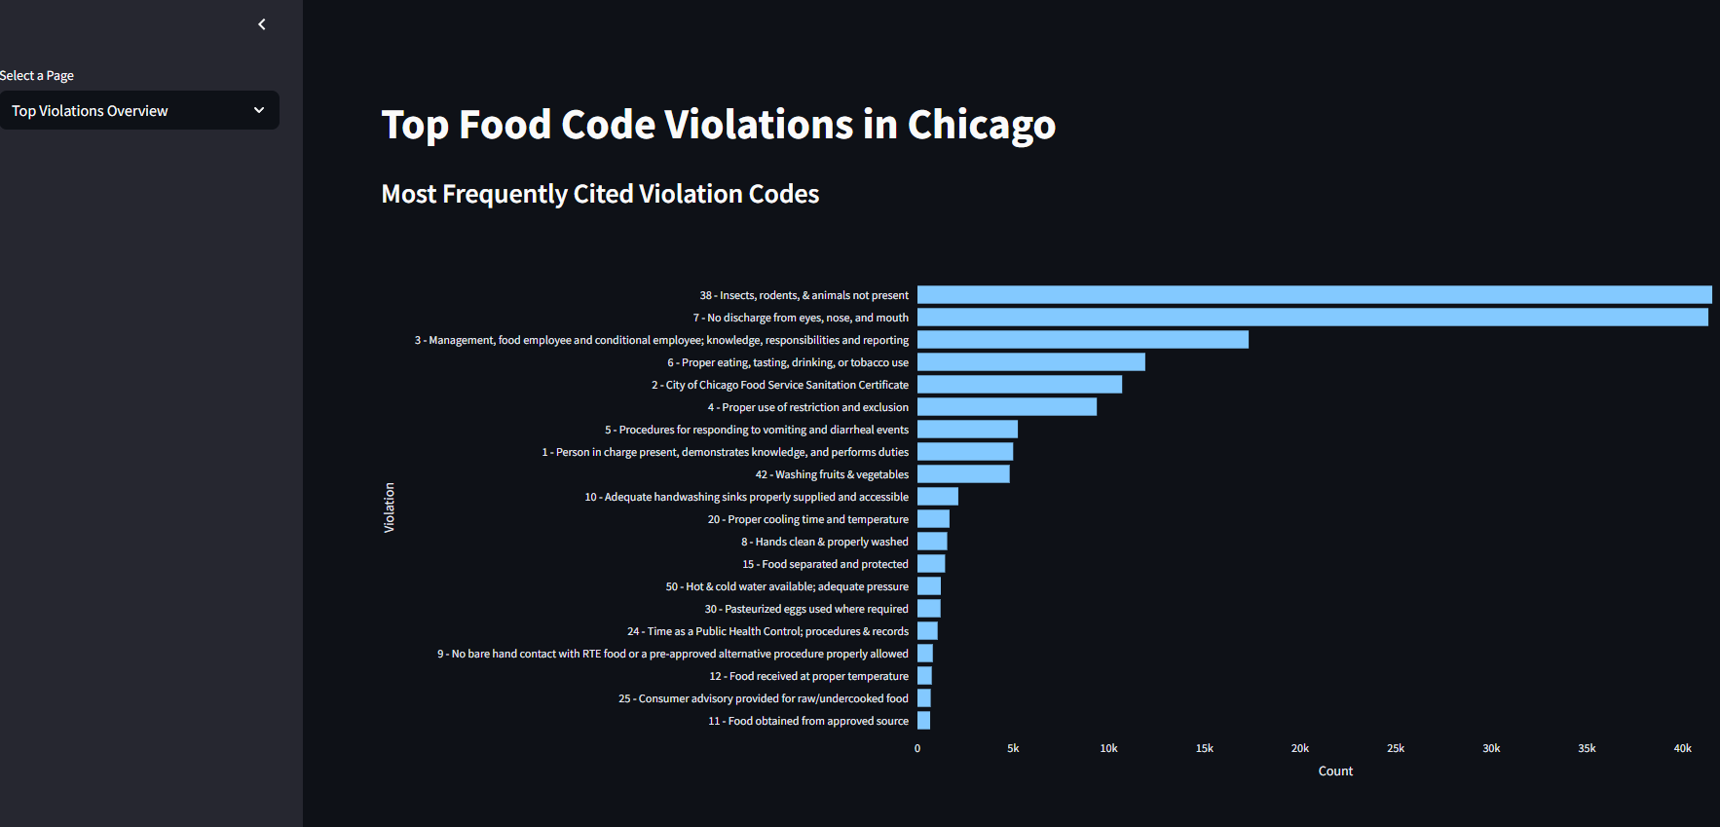

Slide 18
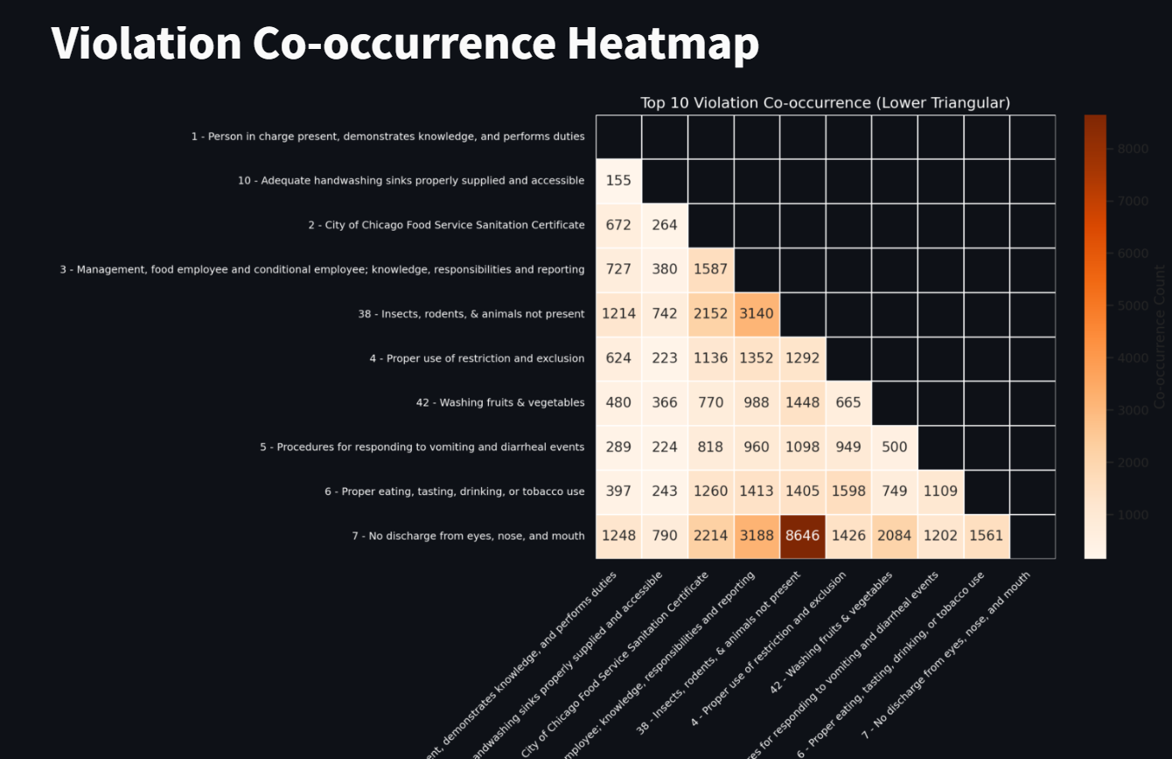

Slide 19
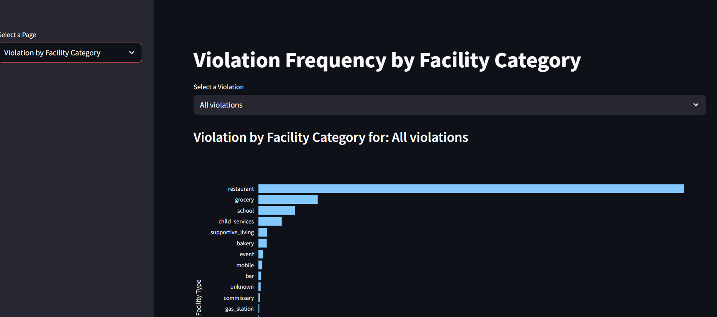

Slide 20
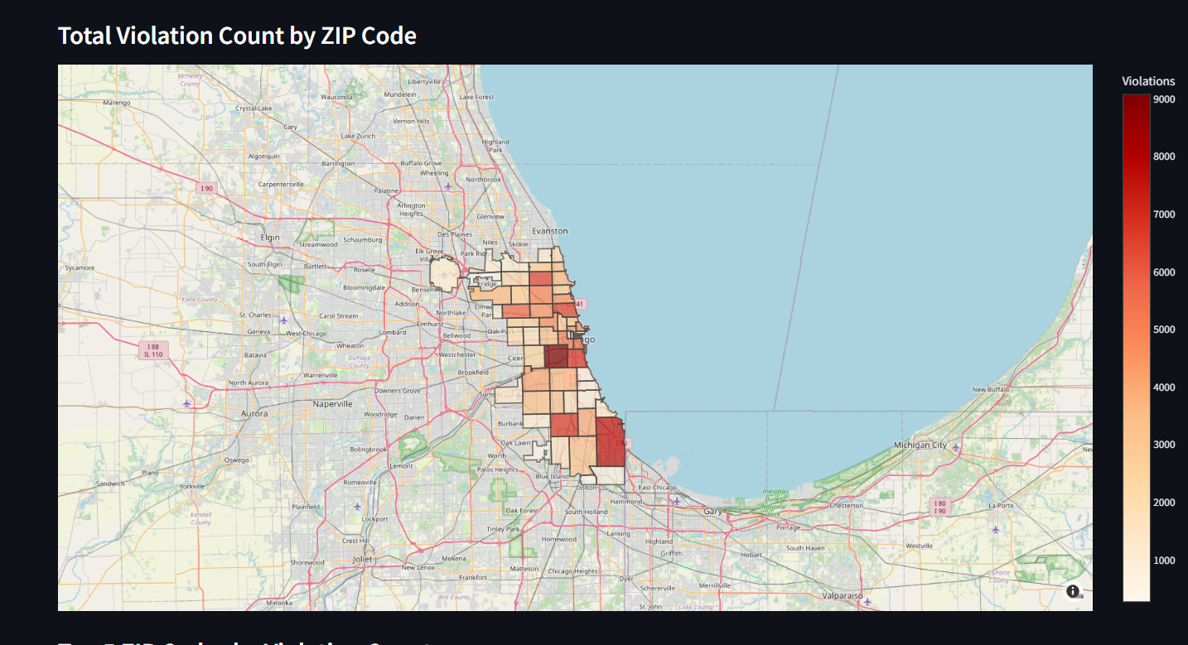

Slide 21
Asynchronous Producer Consumer
Create a producer that sends a message to a message broker queue
Create a consumer that watches the queue, gets the message, and takes an action
Implement on GCP VM.
Orchestrate using Prefect – a Python-based orchestration tool

Slide 22

GCP
Virtual Machine
Virtual Machine
Container
Orchestrater
Message Broker
(RabbitMQ)
Producer
Consumer

Slide 23
